Slide 1
CAPSTONE Event Extraction and trending from Twitter
Joyce Lin, General assembly, data science immersive

Slide 2

POWER of Social Media
Social media started with life sharing; through mail, phone, campus internet….
……And now has gone wild!!
Notes:
People start using social media on getting News, Job Search follow Fashion Trends, new technologies, gages, search restaurants
. And the list goes on and on
And why does it relate to you?
Well
For companies: Branding management: capture feedback on new products, commercials champions, successful crisis management could include capture negative comments quickly on the web to the brand and product
For individual business owners, using trending hashtags meaning better chance to be reached by potential customers.
If you are news editors, capture readers feed back meaning you can capture potential events that’s happening
For everyone else, you always want to be on top of what’s going on instead of being lag, right?

Slide 3
Goal: Realtime event detection framework
Question:
What event do we want to know about?
Questions:
How soon can we catch a trending event?
Notes:
Our goal is to extract a structured representation of events taking place in the world.
I’d like to raise two important questions up front:
The first is which set of events do we want to know about? For the purposes of this talk we’re interested in important or popular events which are “newsworthy”. And not mundane events from users’ everyday lives such as what they ate for breakfast.
The second question is how soon can we know about an event? I think here it’s clear that it’s preferable to know about events as early as possible, preferably before they even take place…
Ability to systematically extract and analyze tweets can not only retrieve of events that mostly watched, the sentiment of the event
In addition to providing a fresher source of information on current events than news (journalists often follow twitter to keep up to date on developing stories), I believe there is reason to be optimistic that despite numerous challenges, open-domain event extraction from Twitter may in fact be easier than from news.

Slide 4
Why Twitter
Real-time results. Because of Twitter’s real-time streaming engine, we can quickly get public opinion
Wide reach. Twitter is used by all age group, many type and size of businesses
Direct feedback. You hear what people are saying as they say it.

Slide 5
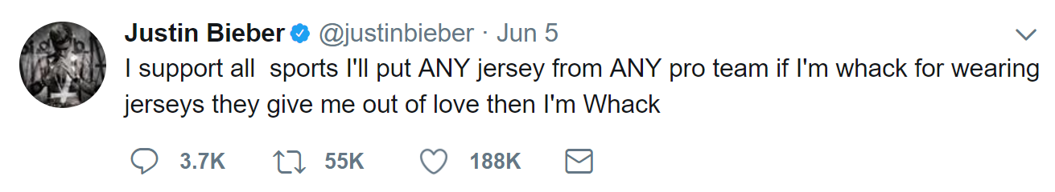
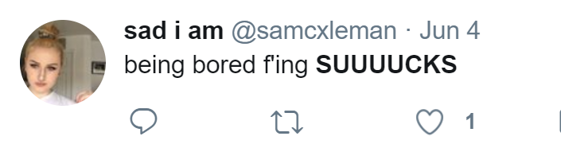
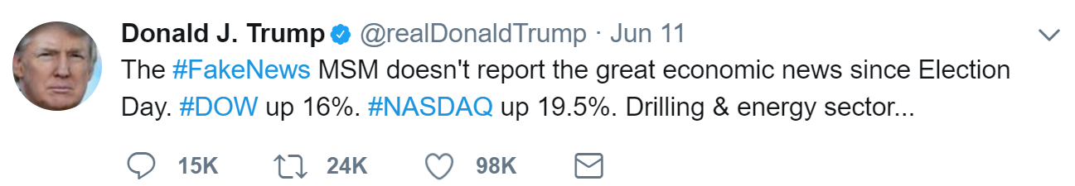
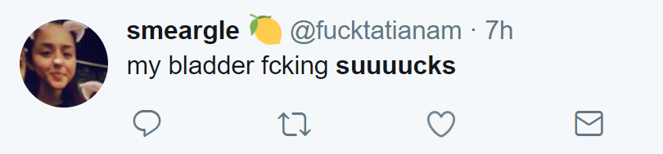
Challenges –Noisy Text
Accumulate quickly. Twitter is used by all age group, many type and size of businesses
Mostly noise. And it is often hard to identify which are and aren’t!
Unique grammar
Lexical Variation. 2mar, tmr, tmoro, tmorrow, tmrw, tomo, tmw, and many……

Slide 6
MY APPROACH
Set up Data Collection process and Data Infrastructure
Examine different Natural Language Processing tools on collected tweets
Create A|B Testing Model on similarity comparison
Use Time Series Modeling to catch the trends
Tuning hyperparameters for model improvement
Notes:
On average600 tweets are tweeted per second, 350k per minute, 500 million per day.
HOW TO EXTRACT USEFUL ONES
Ability to systematically extract and analyze tweets can not only retrieve of events that mostly watched, the sentiment of the event
In addition to providing a fresher source of information on current events than news (journalists often follow twitter to keep up to date on developing stories), I believe there is reason to be optimistic that despite numerous challenges, open-domain event extraction from Twitter may in fact be easier than from news.
More info on how to use this template at www.slidescarnival.com/help-use-presentation-template
This template is free to use under Creative Commons Attribution license. You can keep the Credits slide or mention SlidesCarnival and other resources used in a slide footer.

Slide 7
Set up infrastructure
Created an automated and sustainable data collection process
Collect and clean tweets real-time
Restart the service periodically to clear up potential cache
Automate NLP process
NLP Pipeline
Daily scheduled process to vectorizer pass 7 day tweets to be ready for quick analysis

Slide 8
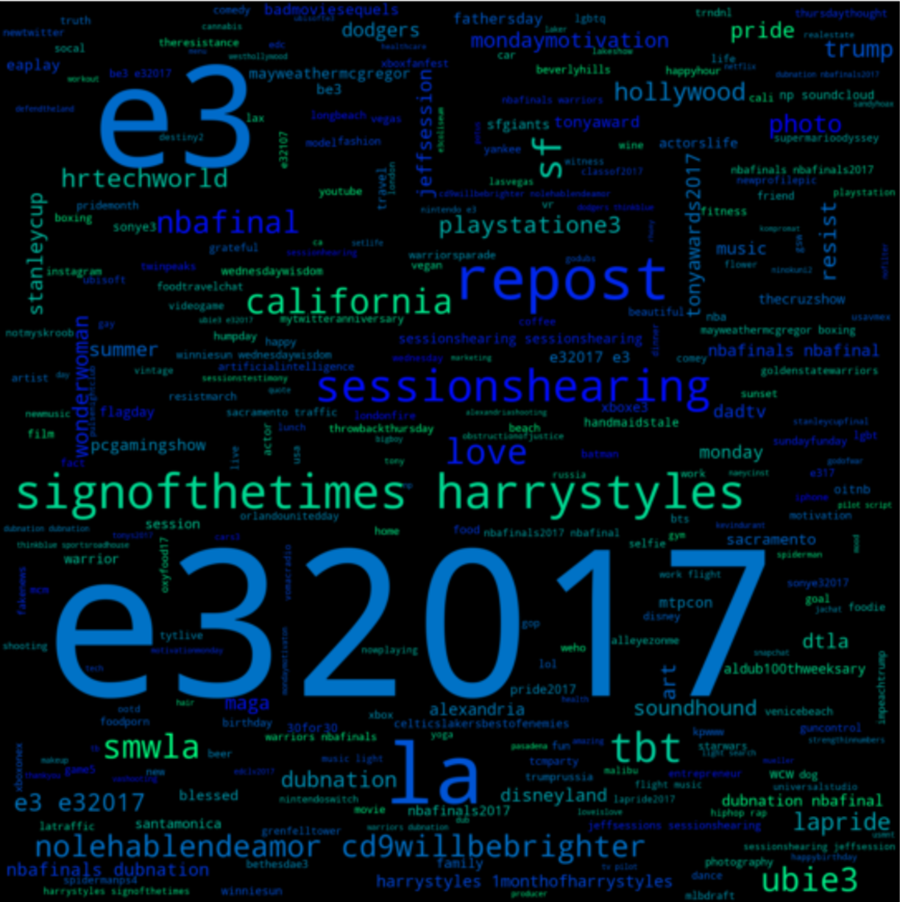
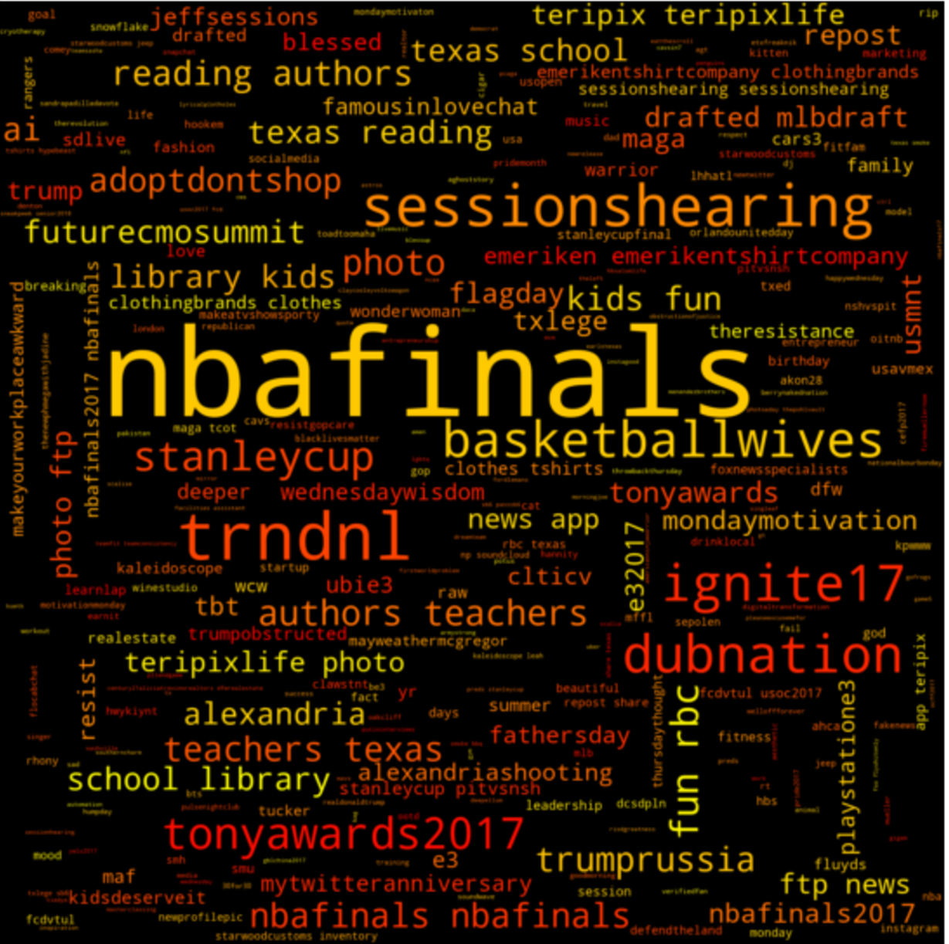
GA @
Santa Monica, CA

Slide 9
Real-Time Process
Scheduled Process | On Demand
Pre Process
SPACY
Postgres
Pre Process
SVD
Redis
Pre Process
TFIDF
Pre Process
Count vectorizer
NLP
Pre Process
Data Cleaning
Data Collection From
twitter
On Demand
Event Detection
Cosine Similarity
Trending Detection
Time Series Analysis
ARIMA Modeling

Slide 10
TOPIC MODELING
In this model, we are trying to extract informational tweets (tweets related to a topic or even) from noise.
We also try to find similarities between tweets weather on the same topic or not
Several Vectorizers were tried in the experiment.
There is no perfect vectorizer from the shelf
We are settle on TFIDF due to it gives us better similarity score

Slide 11
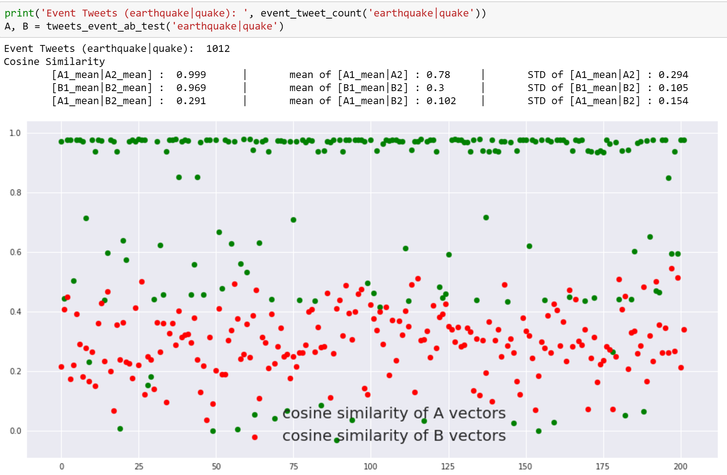
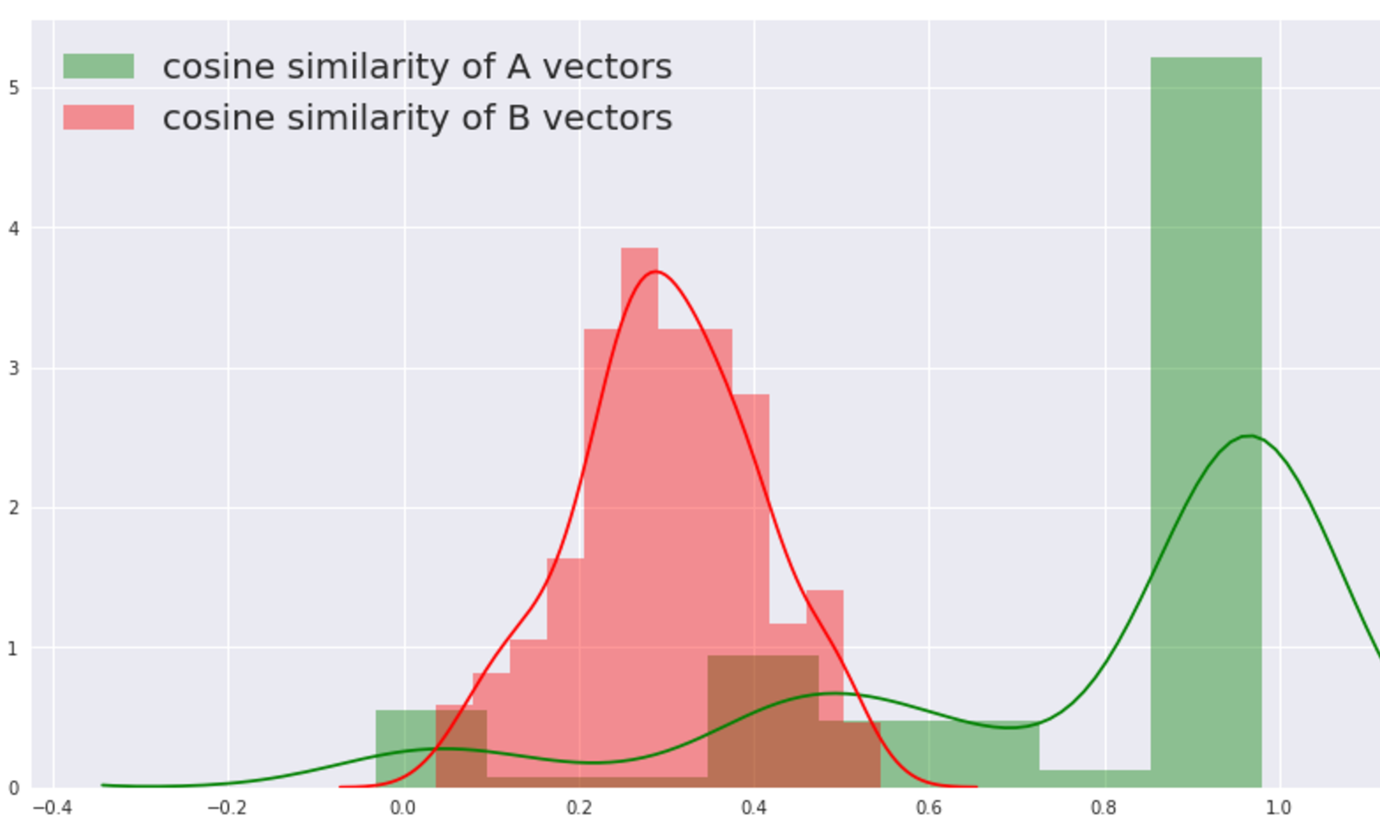
To test how the Vectorizer perform on the tweet dataset
We first extract event tweets as event group (we call it: group A)
Then randomly select same amount of tweets from the rest of dataset (group B)
Split A group randomly into A1 and A2 (in this case we did a 30 / 70 split)
Split B group into B1 and B2 using the same method
Finally, we can exam the similarity between each sub groups using machine learning tool like cosine similarity
TOPIC MODELING
Using
COSINE SIMILARITY

Slide 12

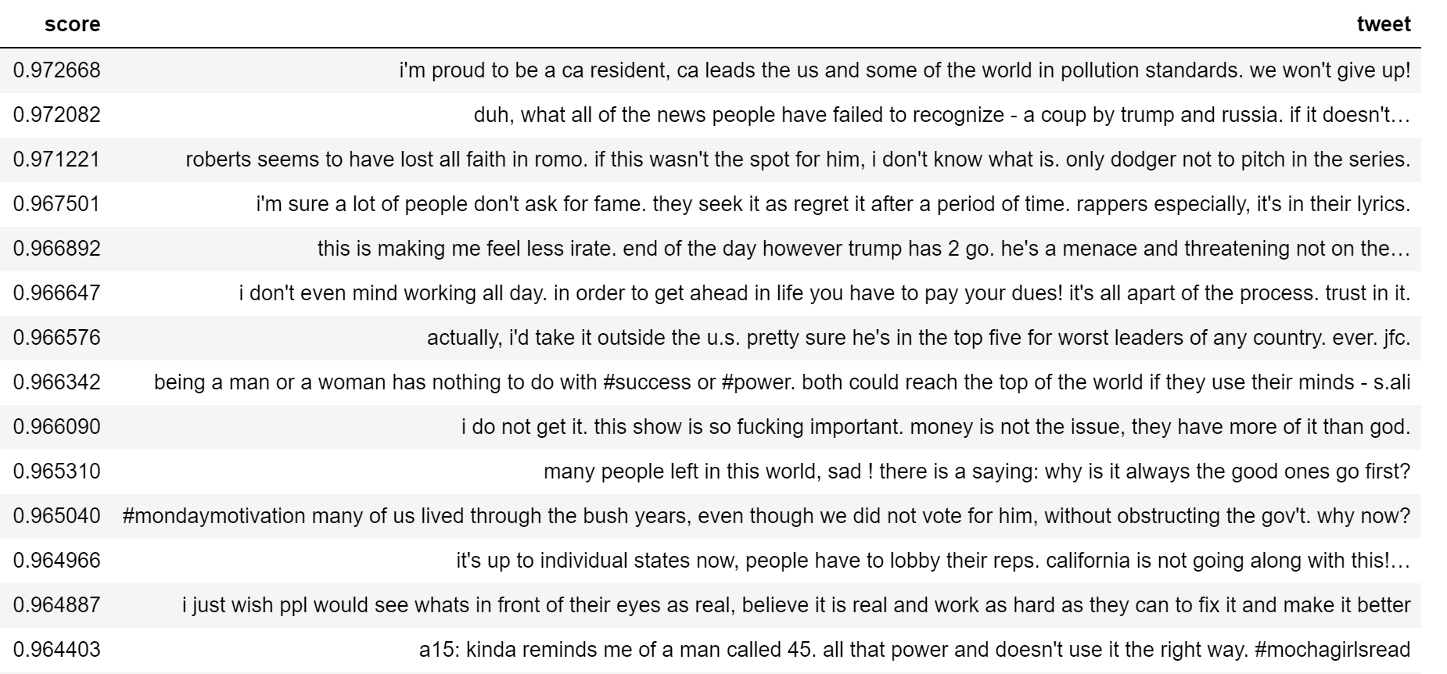
Event detection
cosine similarity using TFIDF/SVD

Slide 13
HASHTAG TIME SERIES MODELING
Trending analysis is highly time dependent.
We could look at past hashtag (positive or negative) trending pattern to determine event impact for both strength and duration
We also hope to predict near term topic trend for running commercial or managing social media activities

Slide 14
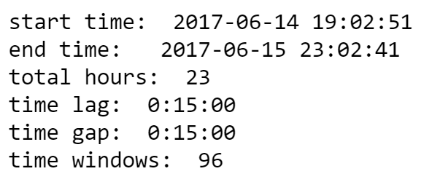
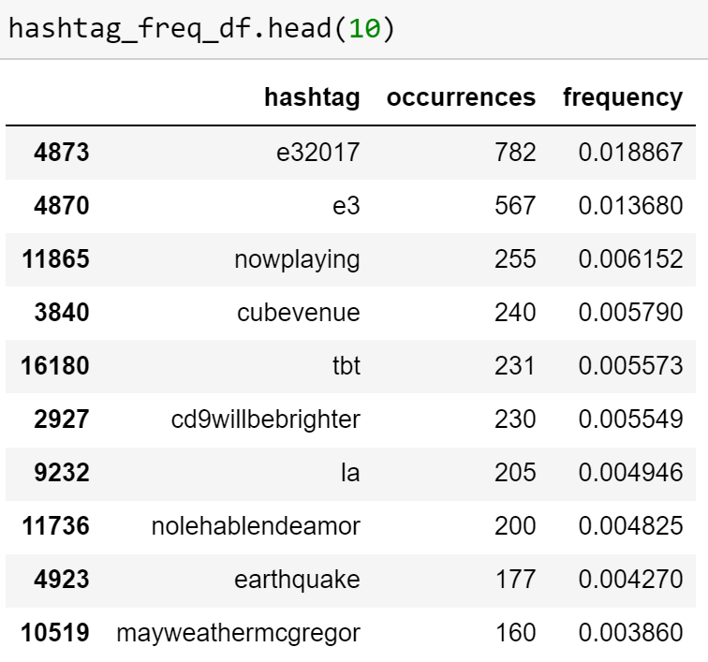
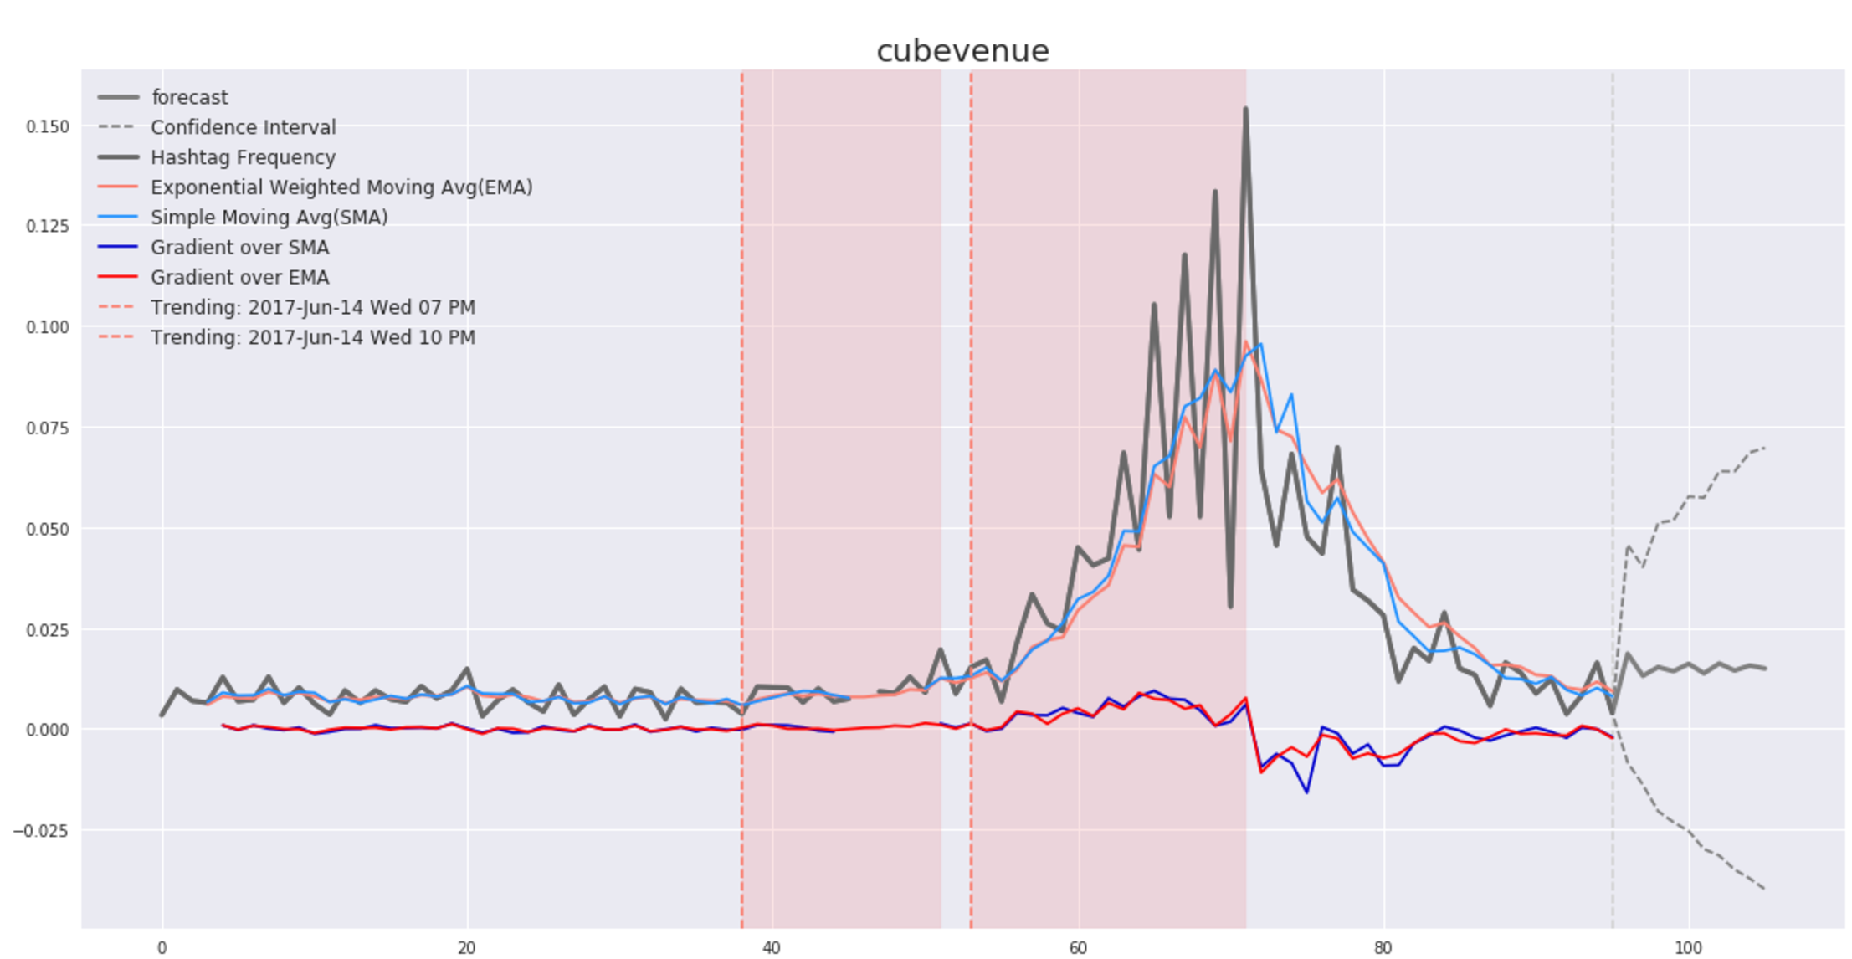

Slide 15
Behind the Scene

Slide 16
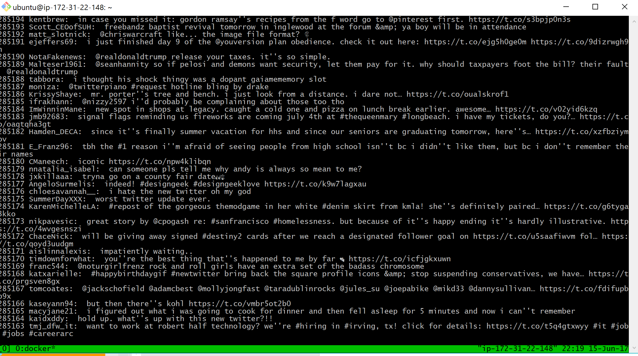

Postgres

Slide 17
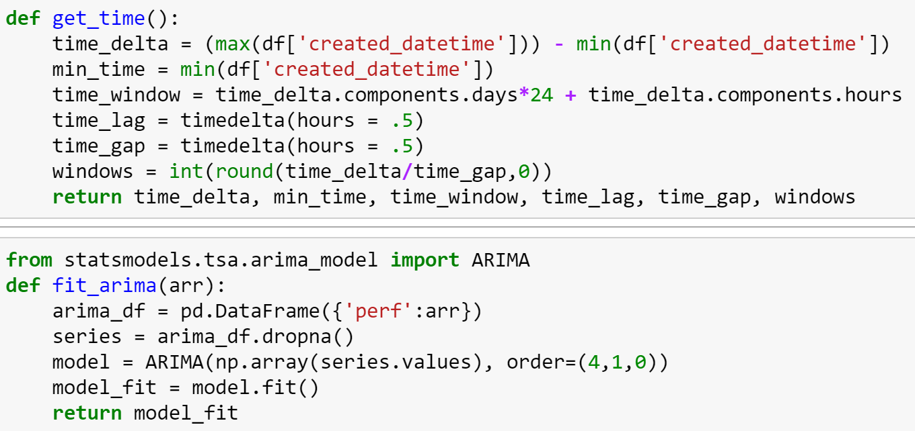
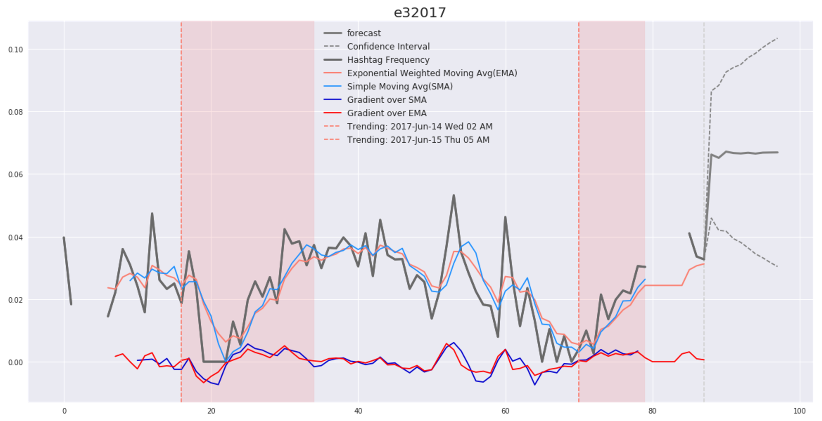
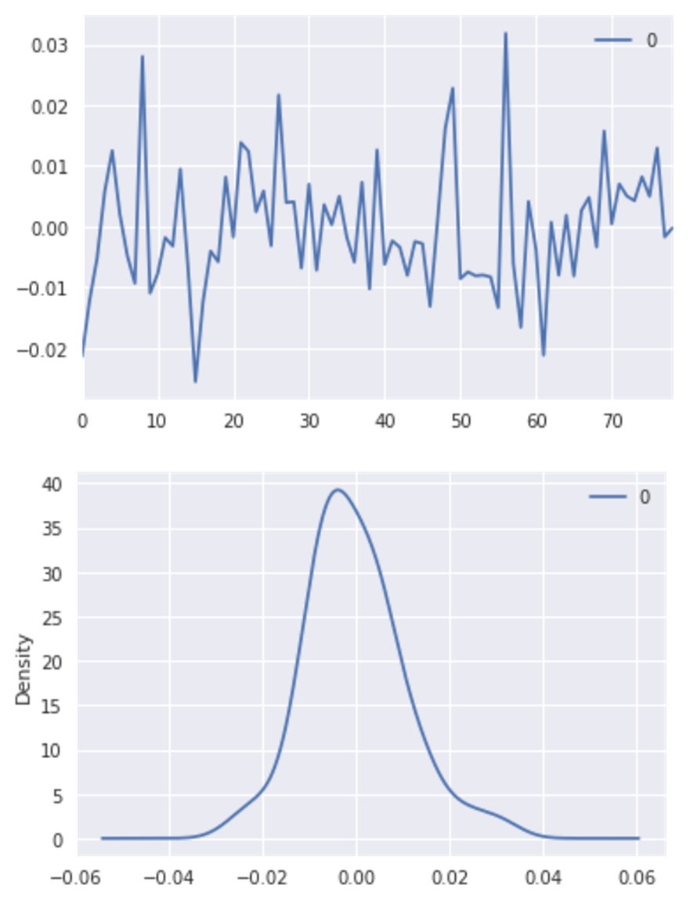
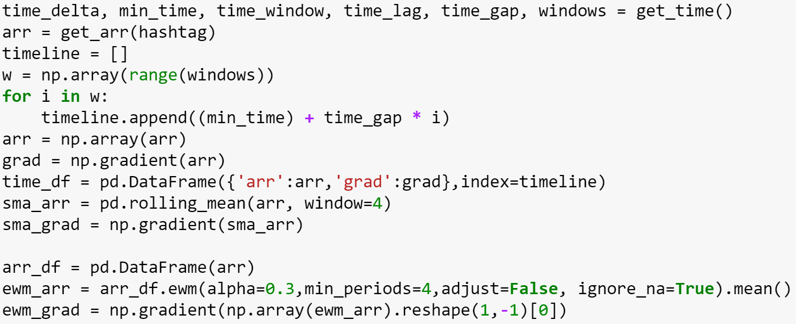
Notes:
Alpha = 1→ EMA = Naïve model (model bias to last observation point)
Alpha = 0 → new forecast = previous year forecast (model bias to first observation point)
(Current period data value * lambda) + (Previous period EWMA * (1 - lambda)) = Current period EWMA
Weighted Moving Average:
WITH repeat_customers as ( SELECT customer_id FROM orders_detail WHERE customer_id IS NOT NULL GROUP BY customer_id HAVING COUNT(distinct order_id) > 1 ), products AS ( SELECT od.product, ROUND(AVG(od.price),2) as avg_item_price, COUNT(distinct rc.customer_id) + 1 as weight FROM orders_detail od LEFT JOIN repeat_customers rc ON rc.customer_id = od.customer_id WHERE od.price IS NOT NULL GROUP BY od.product ) SELECT ROUND(SUM(avg_item_price * weight) / SUM(weight),2) as weighted_avg_item_price FROM products;

Slide 18
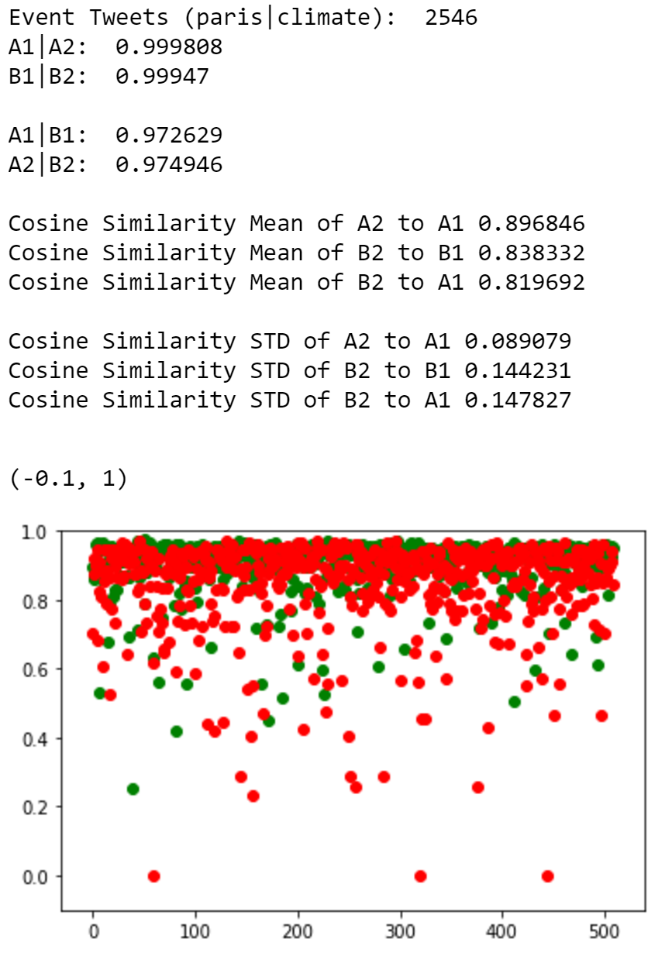
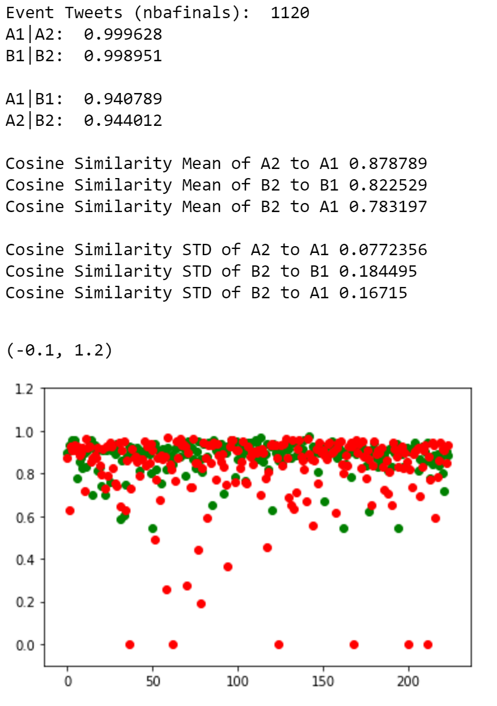
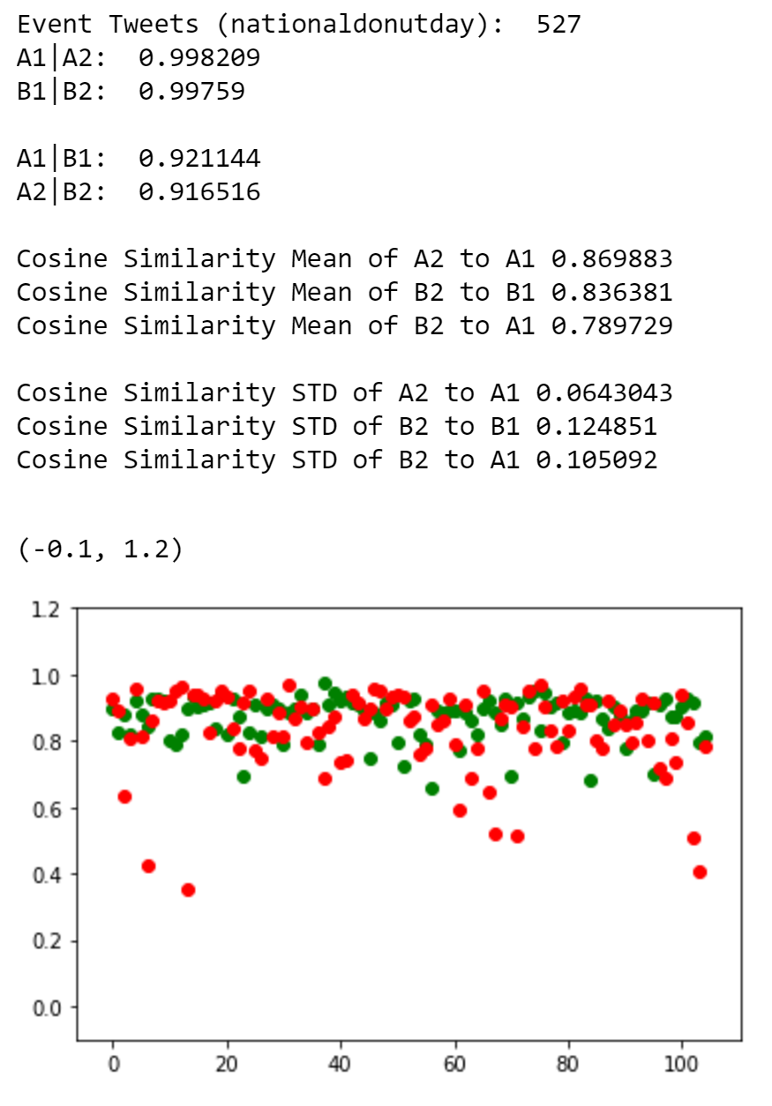
Topic modeling
cosine similarity using spacy

Slide 19
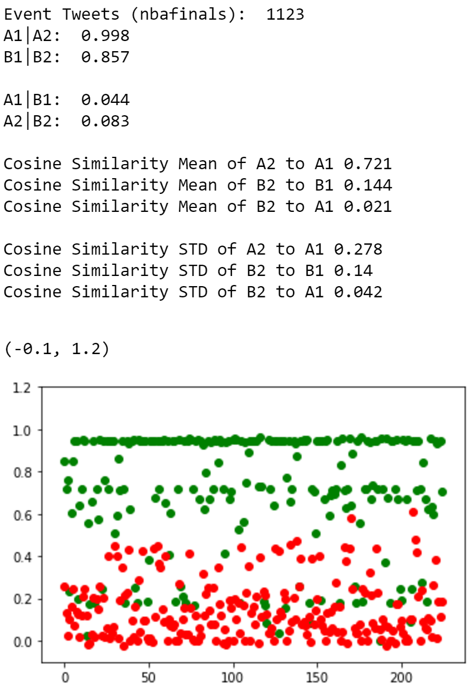
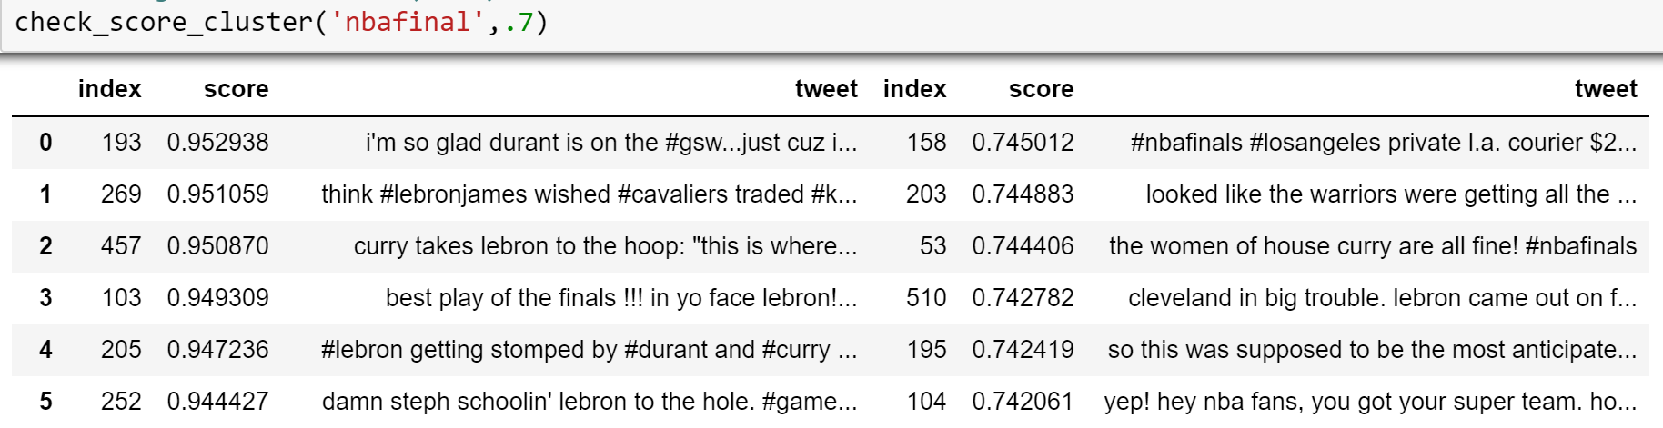
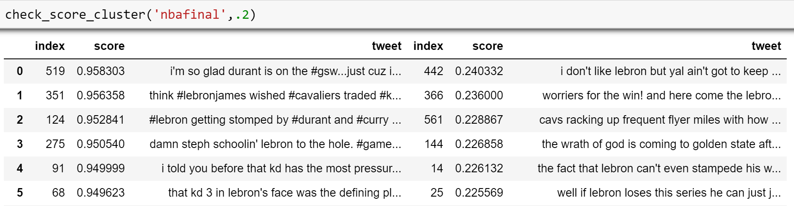
Event Identification lsa (tfidf | svd) - cosine similarity
Event detection
cosine similarity using TFIDF/SVD
Cosine similarity between 2 subset of event tweets (A1 | A2 )
high similarity score on
2 subset of event tweets (A1 | A2 )
Low similarity score on
2 subset of event tweets (A1 | A2 )

Slide 20
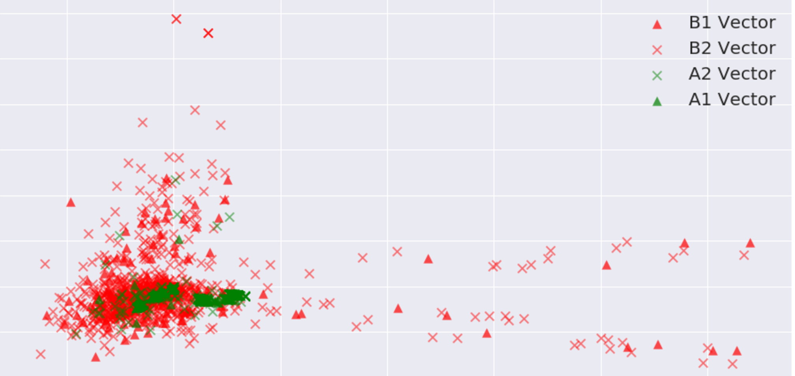
Event Identification lsa (tfidf | svd) - cosine similarity
Topic modeling
cosine similarity using TFIDF/SVD
Plot of tweet vector spaces in
top 2 components from singular value decomposition (SVD)

Slide 21
Future work
Topic Modeling
Explore other vectorizers such as “tweet2vec”
Time Series Analysis
Implement custom Weighted Moving Average
Find optimal learning constant (alpha) for EMV
Geospatial Modeling
Expend geographical coverage to more cities and states

Slide 22
THANK YOU
You can find me @
GitHub: joyce-lin
Linkedin: joyce-ch-lin
Gmail: joyce.ch.lin@gmail.com
GA Profile:

Slide 23

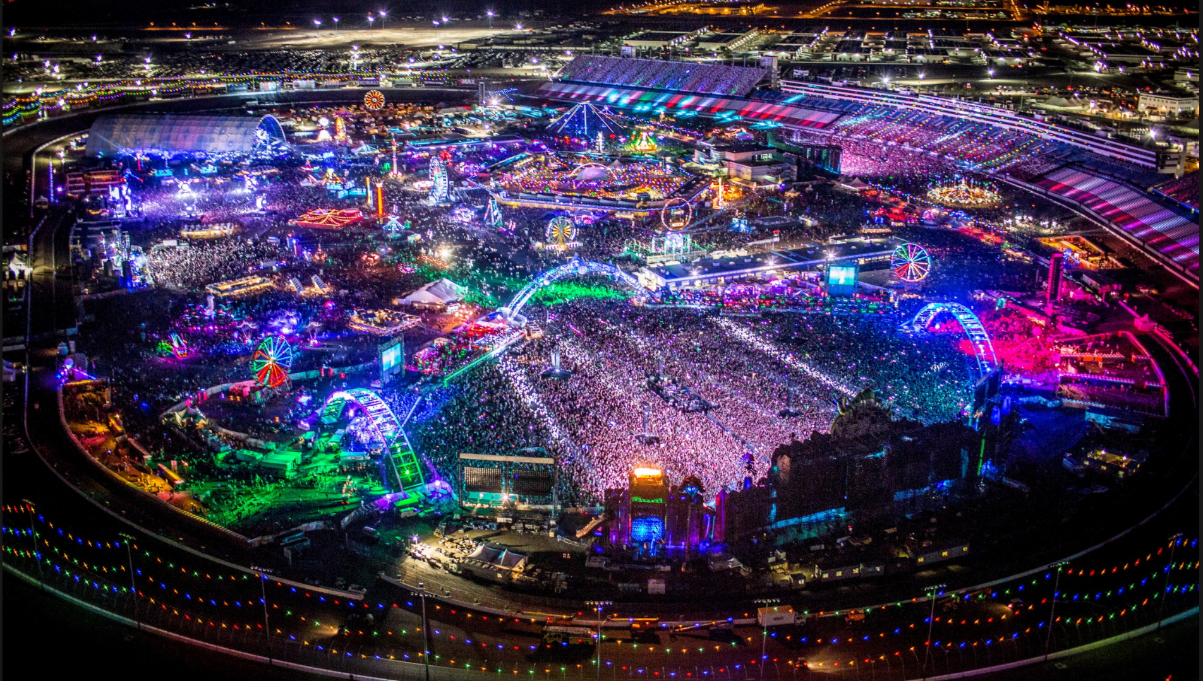
End

Slide 24
AND TABLES TO COMPARE DATA
 | A | B | C
Yellow | 10 | 20 | 7
Blue | 30 | 15 | 10
Orange | 5 | 24 | 16

Slide 25
89,526,124
Whoa! That’s a big number, aren’t you proud?

Slide 26
89,526,124$
185,244 USERS
100%
That’s a lot of money
And a lot of users
Total success!

Slide 27
OUR PROCESS IS EASY
first
second
last

Slide 28
TABLET PROJECT
Show and explain your web, app or software projects using these gadget templates.
Place your screenshot here

Slide 29
DESKTOP PROJECT
Show and explain your web, app or software projects using these gadget templates.
Place your screenshot here

Slide 30
THANKS!
Any questions?
You can find me at
@username
user@mail.me

Slide 31
PRESENTATION DESIGN
This presentation uses the following typographies and colors:
Titles: Oswald
Body copy: Roboto Condensed
You can download the fonts on these pages:
https://www.fontsquirrel.com/fonts/oswald
https://www.fontsquirrel.com/fonts/roboto
Dark aqua #3796bf / Aqua #4bb5d9 / Light aqua #81d1ec
Yolk yellow #ff9900
You don’t need to keep this slide in your presentation. It’s only here to serve you as a design guide if you need to create new slides or download the fonts to edit the presentation in PowerPoint®

Slide 32
SlidesCarnival icons are editable shapes.
This means that you can:
Resize them without losing quality.
Change fill color and opacity.
Change line color, width and style.
Isn’t that nice? :)
Examples:

Slide 33
😉
Now you can use any emoji as an icon!
And of course it resizes without losing quality and you can change the color.
How? Follow Google instructions https://twitter.com/googledocs/status/730087240156643328
✋👆👉👍👤👦👧👨👩👪💃🏃💑❤😂😉😋😒😭👶😸🐟🍒🍔💣📌📖🔨🎃🎈🎨🏈🏰🌏🔌🔑 and many more...

